Slide 1
Welcome

Slide 2
MAKING THE MOST OF THIS COURSE

Slide 3
no required programming experience

Slide 4
no required platform

Slide 5
no required background

Slide 6
WHAT IS PROGRAMMING?

Slide 7
“A computer program is a
set of instructions…”

Slide 8

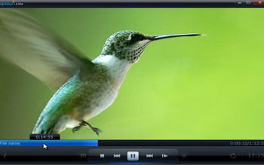


Slide 9
turn right
drive one mile
turn left on bank
take the second right
fourth house on the left

Slide 10
turn right
drive one mile

Slide 11
200 + 300 = 500
X

Slide 12
STATEMENTS
BASIC LET Balance = 500
AppleScript set balance to 500
Java balance = 500;
COBOL MOVE 500 TO BALANCE

Slide 13
“programming is the ability to take this idea in your head, break it apart into its individual pieces”

Slide 14
WHAT IS A PROGRAMMING LANGUAGE?

Slide 15
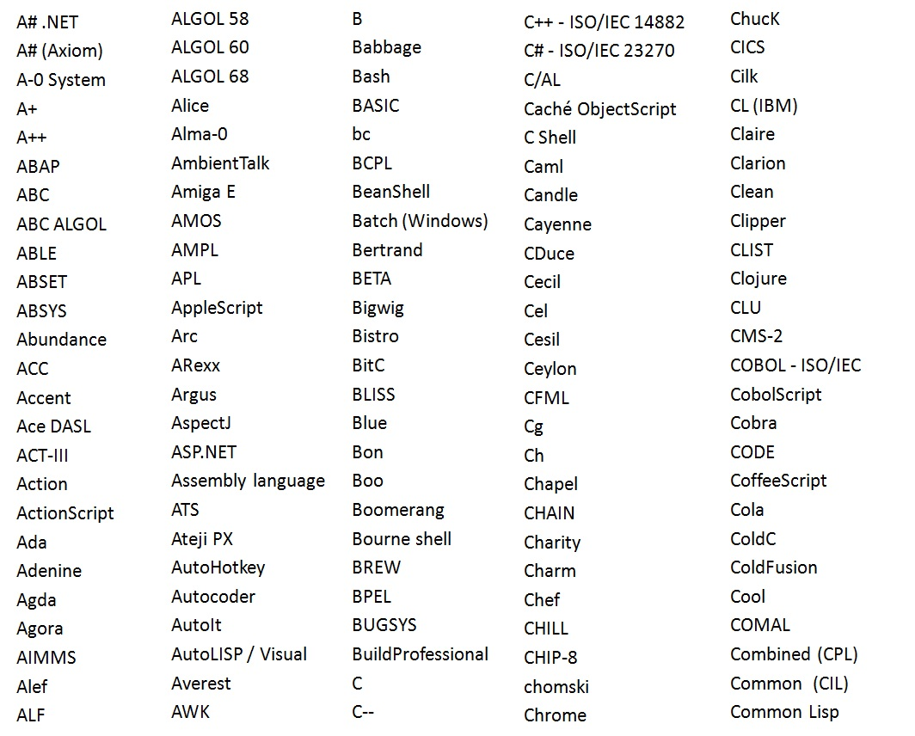

Slide 16
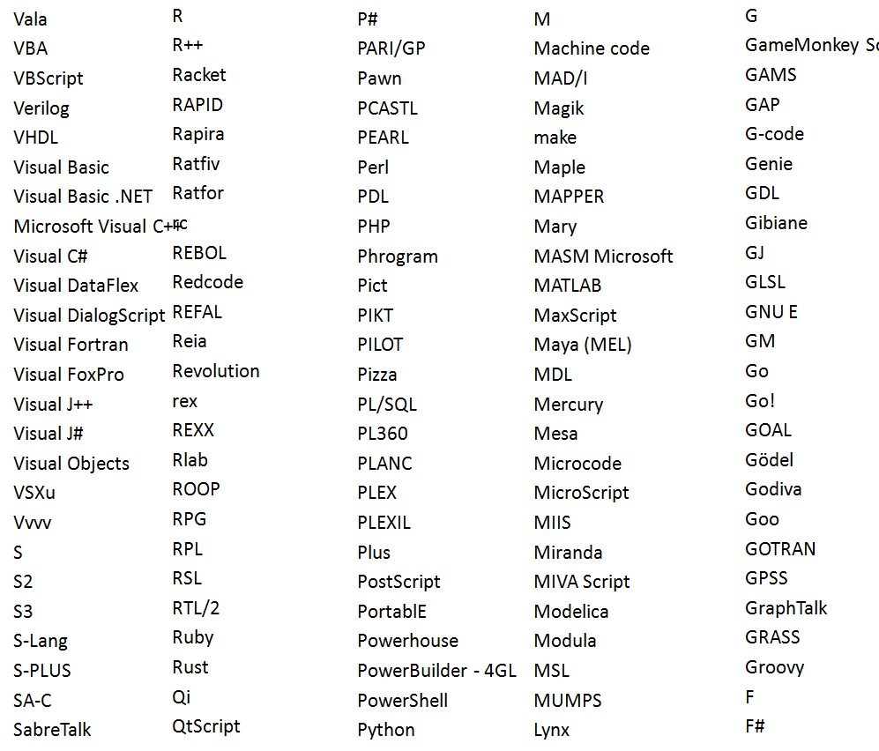
C
C++
C#
Java
JavaScript
Perl
PHP
Python
Objective-C
Ruby
Visual basic

Slide 17
6A
10
04
0C
55
48
EC
00
14
4C
48
00
00
00
00
00
14
00
89
48
00
48
8D
89
00
01
E9
00
01
E9
8D
65
00
00
00
00
FA
83
00
89
3D
4D
89
00
0A
1D
6C
00
E5
C2
08
89
48
00
46
E4
FF
12
65
81
G4
2G
6B
1B
00
5G
F2
F2
D3
E8
88
89
00
0B
0A
1B
1A
2B
2A
3C
D3
D4
5F
FF
DD
AA
B1
11
BB
CC
C8
C9
10
20
2F
F0
6A
10
04
0C
55
48
EC
00
14
4C
48
00
00
00
00
00
14
00
89
48
00
48
8D
89
00
01
E9
00
01
E9
8D
65
00
00
00
00
FA
83
00
89
3D
4D
89
00
0A
1D
6C
00
E5
C2
08
89
48
00
46
E4
FF
12
65
81
G4
2G
6B
1B
00
5G
F2
F2
D3
E8
88
89
00
0B
0A
1B
1A
2B
2A
3C
D3
D4
5F
FF
DD
AA
B1
11
BB
CC
C8
C9
10
20
2F
F0
F3
D5
D0
89
00
A2
A5
B2
B5
00
89
3D
4D
89
00
0A
1D
6C
00
E5
C2
08
89
48
00
46
E4
FF
5D
D0
89
E4
B0
A1
F3
3D
3B
BB
50
F0
D0
A1
D1
D3
D4
5F
FF
DD
AA
B1
11
BB
CC
0A
1D
6C
00
E5
C2
08
89
48
00
46
E4
FF
5D
D0
89
E4
B0
A1
F3
3D
3B
BB
50
F0
D0
A1
D1
D3
D4
5F
FF
DD
AA
B1
11
BB
CC

Slide 18
JavaScript, ActionScript
High-Level Languages
Ruby, Python, PHP
Java, C#, VB.NET
Objective-C
C++
C
Low-Level Languages
Assembly Language
Machine code
CPU

Slide 19
WRITING SOURCE CODE

Slide 20
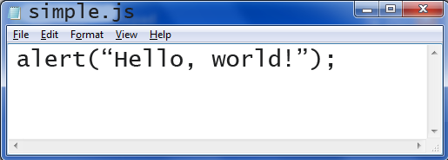
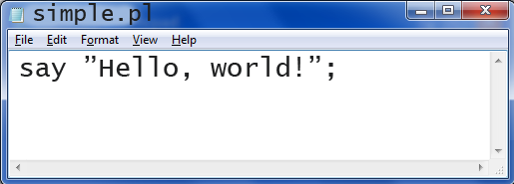
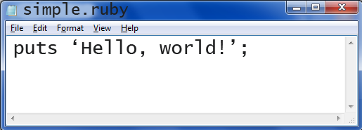


Slide 21
print(“Hello, World!”)
ALGOL 68
ALGOL 68 / Python 3 /
Python 3
Lua

Slide 22
ALGOL 60 BEGIN DISPLAY (“Hello, Wolrd!”); END.

Slide 23
C #include <studio.h> int main(void) { printf(“Hello, world\n”); return 0; }

Slide 24
C# using system; class Example { static void Main(string[] args) { Console.WriteLine(“Hello world!”); } }

Slide 25
Java public class HelloWorld{ public static void main(string[] args){ System.out.println(“Hello, World!”); } }

Slide 26
LANGUAGE EXAMPLES
Compiled C, C++, Objective-C
Interpreted PHP, JavaScript
Hybrid Java, C#, VB.NET, Python

